Slide 1
Business in the Pandemic & Beyond
Gwendolyn Ge, Zhengmeng Liu,
Mohamed Mohamed, Harry Wang, Zhao Zhang

Slide 2
Problem Statement
Business Problem: Which city in BC has businesses that are more resilient to the covid pandemic?
Related Question 1: What is the % change in average number of reviews on Yelp before and after covid by city?
Related Question 2: What is the % change in Yelp average star ratings before and after covid by city?
Our Purpose: We aim to identify the suitable environment and elements that help small business starters thrive in the BC area.
Notes:
Based on these negative impacts on businesses, we would like to help small business owners who want to start a new business in a city of BC. We want to advice them on picking a city that is more resilient to changes during the pandemic, and ideally help them to choose the most suitable type of business. While many businesses are closing, more new businesses are on the way. We want to help small business owners to start their businesses right and make the decision which would help them to take less impacts from the pandemic. We can use our analysis to offer some insights on whether business performance (indicated by number of Yelp reviews and overall star ratings) is better in certain cities in BC as covid cases continue to increase.
Business problem: Which city in BC has businesses that are more resilient to the covid pandemic, thus more suitable for starting a small business?
Questions:
What is the change in average number of reviews on Yelp before and after covid by city?
What is the change in average star ratings before and after covid by city?
We would like to use datasets from Yelp, one of the most popular review and rating platform in BC, to investigate these questions and provide insights on startup ideas for business owners. Review counts (time-series) and star ratings will be used as proxies to indicate the performance and popularity of businesses. Another dataset from the Government of Canada is used to provide information on daily covid cases update, as a proxy to the severity and progression of pandemic.

Slide 3

Background
In BC, small businesses are facing big challenges during the pandemic.
90% of businesses are impacted, and 75% of them are facing significantly negative impact.
83% of impacted businesses are experiencing decreases in revenue.
73% of businesses expect revenues to drop by at least 50%.
Notes:
Since the pandemic hits in early 2020, the Canadian government implemented a series of social distancing measures in response to the rising cases across Canada. One of the measures is to prohibit public gathering and advising consumers to shelter at home. One of the consequence of these measures is that many businesses, such as restaurants and gyms, are closing or limiting number of customers. The pandemic definitely causes majority of businesses to face decrease in demand and revenue, and the situation is even worse for small businesses.
In BC, small businesses are facing big impacts. A recent survey has shown that 90% of businesses are impacted, and 75% of them are facing significant negative impact. Moreover, 83% of impacted businesses are seeing a decrease in revenue and most of them expect their loss to be even larger in the near future. In addition, 73% of the businesses expect a drop of more than 50% in their revenues.
Reference:
Dunne, D. (n.d.). An update on covid-19's impact On BC's small business community. Retrieved April 14, 2021, from https://smallbusinessbc.ca/article/an-update-on-covid-19s-impact-on-bcs-small-business-community/#:~:text=90%25%20of%20businesses%20are%20%E2%80%9Ccurrently,%2C%20business%2C%20or%20deal%20flow%E2%80%9D&text=73%25%20of%20businesses%20expect%20their,will%20drop%20by%20100%25)

Slide 4
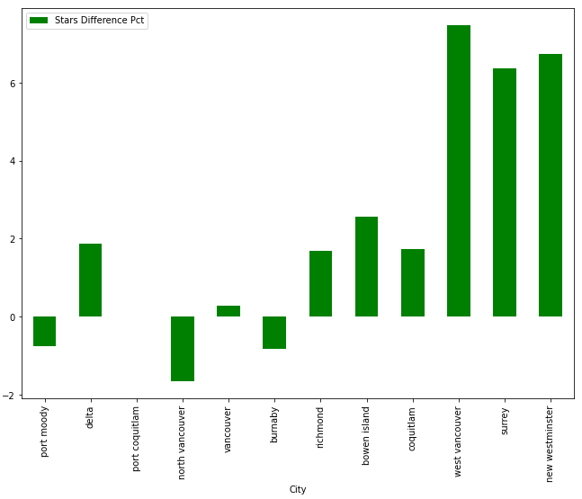
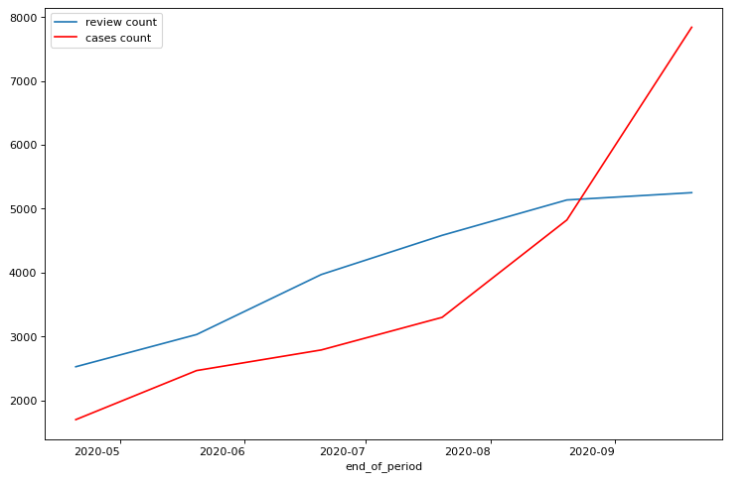
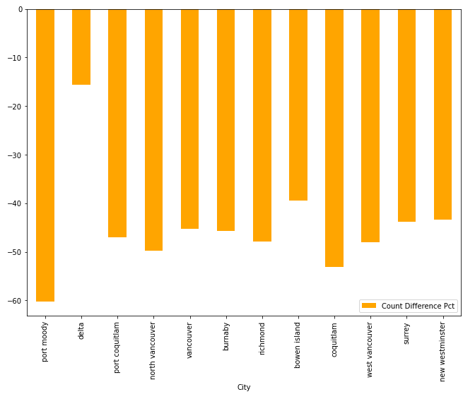
Covid Impacts
Relationship between rates of increase in Yelp review count and covid cases count since March 20th, 2020 (Beginning of prohibition of all dine-in and personal service establishments)
Rate of change in Review Volume and Average Ratings across British Columbia Cities (post-Covid v. Pre-Covid)
Notes:
First, almost all major areas within the BC area has a significantly lower review volume after covid. This is intuitive since quarantine and shut-down policies naturally and significantly reduced businesses activities around the area. However, if we look at the stars difference, most areas actually has higher average review stars in the post-covid period. This could be due to the fact that people are more appreciative of the businesses who remain open and accessible during this period, or it could be due to survivor bias, such that only the higher-quality businesses has survived and remained after the covid hit. For our entrepreneur that is seeking to open a new business after the covid pandemic impact, this could mean that the existing competition are of high quality and has accumulated loyal customers during the covid period.
Secondly, We create time series plot to compare developing trends for review count and cases count. The two curves represent cumulative counts on review and covid cases, respectively. Instead of looking at the absolute values, we are concentrating on the 'changing rate' of these two curves and trying to relate their slopes in real world context. We started to count from May, and these two curves are increasing in a similar trend. Starting from June, British Columbia has survived the first peak and flattened its covid cases curve; as a result, the review count curve increases at a higher rate. This could be because as the pandemic eased, people tended to go out and dine in restaurants so they are likely to leave more reviews on their qualities. From August onwards, the second wave of COVID impacted BC more seriously than the first wave, with the covid cases curve driving up at a significantly high rate; we are expecting an opposite direction for the review count curve because customers might be afraid of being infected by other guests so they sought for alternative approaches for dining in, maybe takeout or delivery. Being physically absent, they will know less about the restaurant and are less likely to leave reviews.

Slide 5
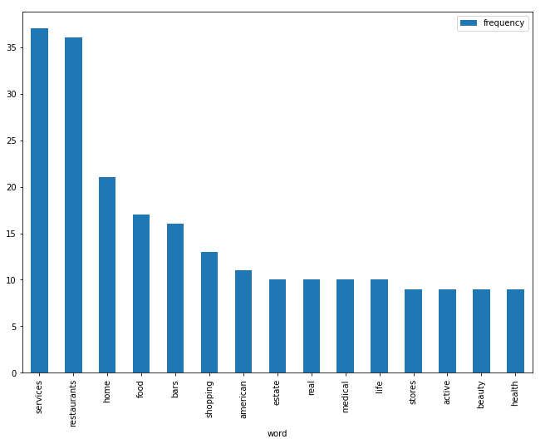
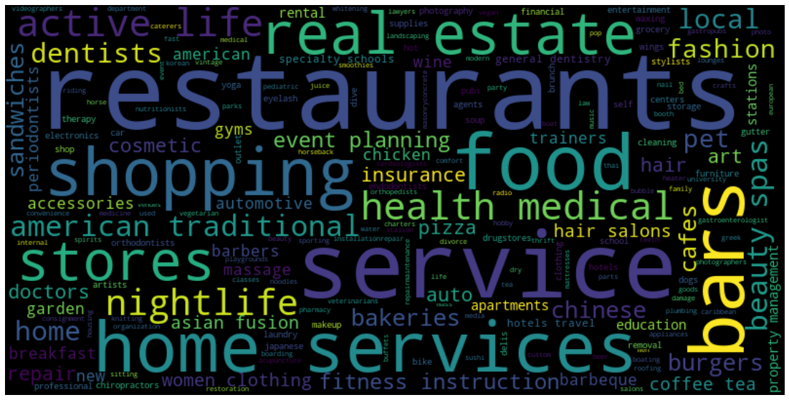
Top 100 Performing Business Keywords
Word Cloud of business keywords
Plot of top 15 most frequent categorical labels for the best-reviewed businesses in BC in the post-covid era
Top hits: restaurants, home services & food
Popularity elements of active life, health, and medical
Notes:
Among the top 100 businesses (by average star ratings) in the post-covid period, we generate a word cloud and identify the most appeared words in the business category labels, to obtain insight on businesses that are most-popular and of the highest quality. Notably, Life-essential related labels such as home, food, real estate appear among the top labels. Moreover, there are some attributes that may be specific to the covid impact, such as medical, health, and active life, which indicates the consumer focus on health-conscious businesses. Surprisingly, we can see that some bars, restaurants and beauty shops are doing really well, which is counter-intuitive but sensible since these are the predominate businesses on yelp.

Slide 6
Conclusion
Most resilient cities: Vancouver & Burnaby
Lowest % change in star rating & number of reviews
Stable business environment
Recommendation:
Start a small business in a more resilient city (Vancouver/Burnaby)
Incorporate health and active lifestyle related elements
Notes:
The Covid-19 pandemic undoubtedly deteriorated the business environment in the BC area. Among all major cities in the BC province, we see a 40-50% decrease in volume. On the contrary, there's a variation in the performance of average stars ratings among different cities. In areas such as Burnaby and Vancouver, we observe an increase in quality (proxied by average stars ratings) in the post-covid period. As stated in the results section, we suspect this is due to survivor bias, indicating the existing competitions are of high-quality to begin with. Therefore, the overall business environment is harsh for entrepreneurs/small business starters, who's looking for a rapid growth period when they first establish the business.
From a business environment perspective, we recommend businesses to start in a resilient city such as Burnaby or Vancouver, whose average star ratings remain at the same level and the business volume (proxied by review count) has suffered the least. These environments are likely to have a stable stream of customers and businesses opportunities. However, from a competition/entry perspective, we recommend small businesses to start at a location such as north Vancouver, where both the quality and volume of businesses has seen larger declines. These areas possibly has a low entry barrier, weaker competitors, and less loyal customers.
With regard to the type/industry of business, traditional services and businesses such as restaurants and shopping still has a strong presence. But we're also seeing labels such as active life, medical, and health to be among the top performing businesses in the BC area. The Covid-19 pandemic has elevated people's alertness and appreciation for health-consciousness and an active lifestyle, and its remaining shockwaves are likely to persist into the future. Therefore, regardless of going for a traditional shop or a niche and target-specific business, the entrepreneur should consider incorporating the aforementioned elements into their branding and operational strategies

